Slide 1
Image Classification & Training of Neural Networks
Credit: CS143 by James Tompkin

Slide 2
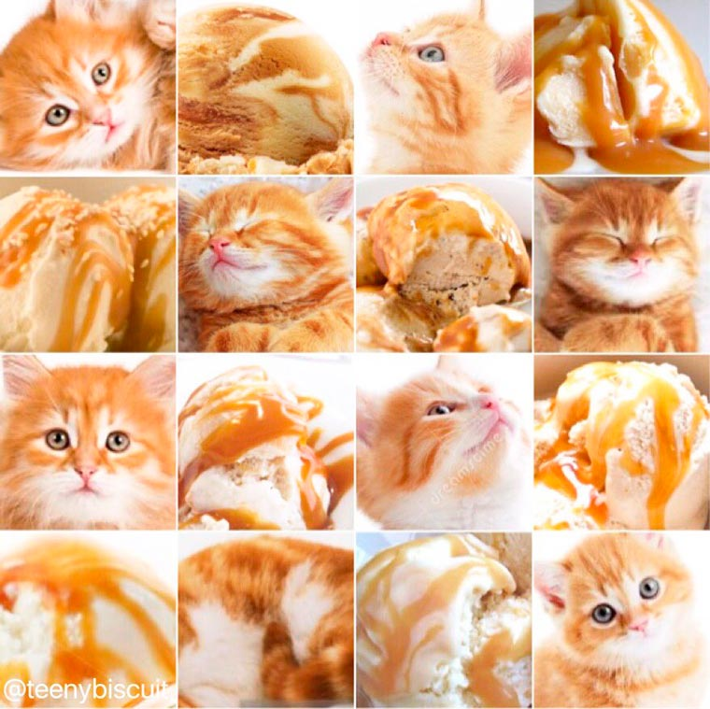

Slide 3
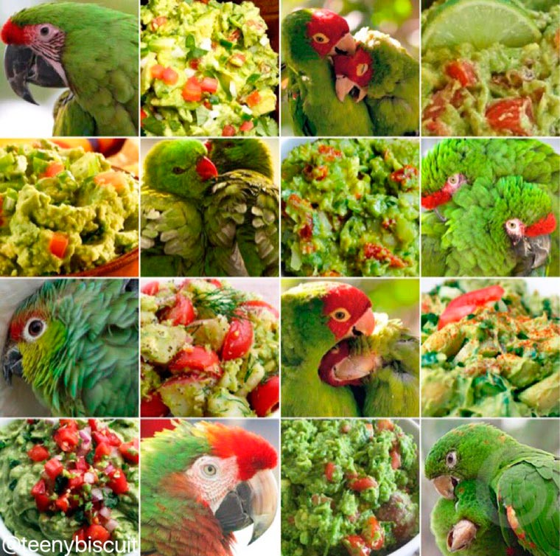

Slide 4
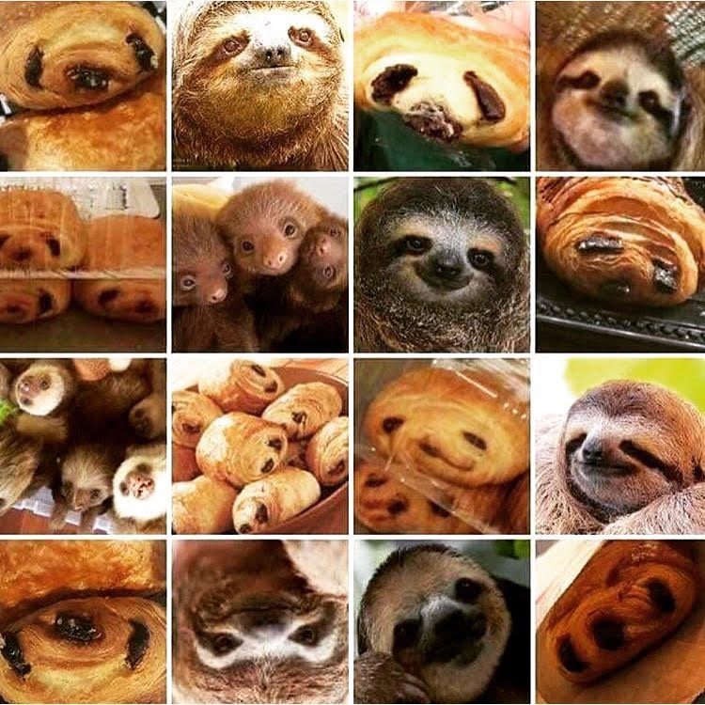

Slide 5
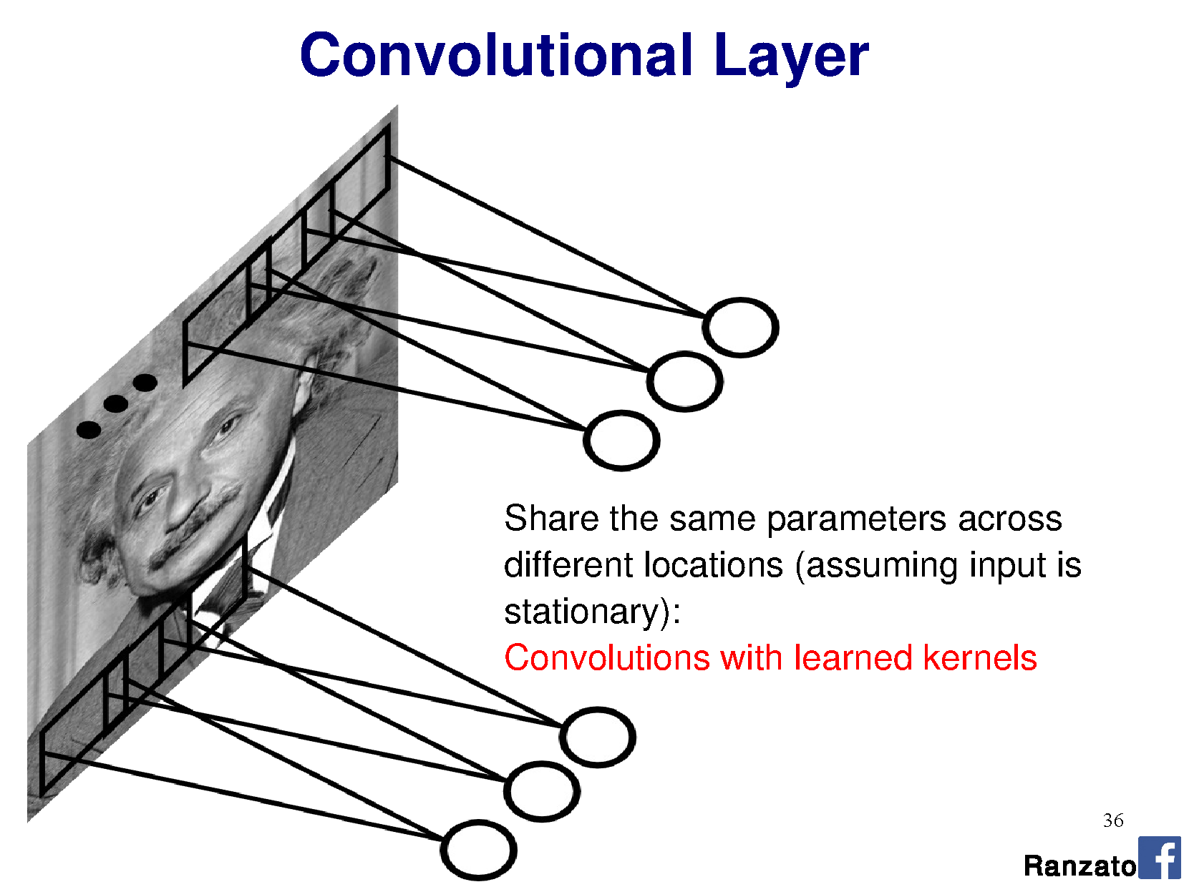
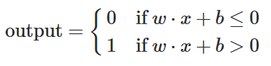
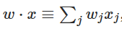
Perceptron:
This is convolution!

Slide 6
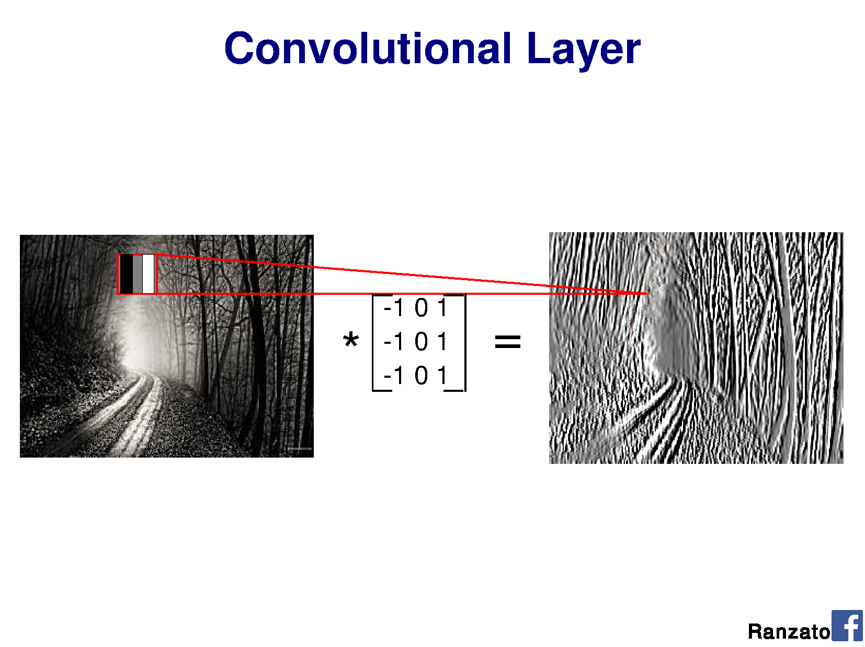
v
v
v
Shared weights
v
Notes:
Output should be a little smaller, as we aren’t padding

Slide 7
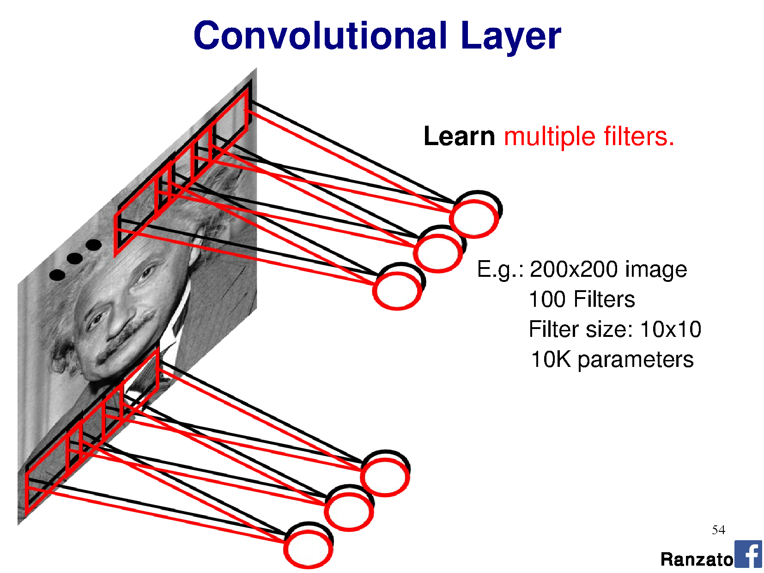
Filter = ‘local’ perceptron. Also called kernel.
Notes:
This is the major trick.
For each layer of the neural network, we’re going to learn multiple filters.

Slide 8
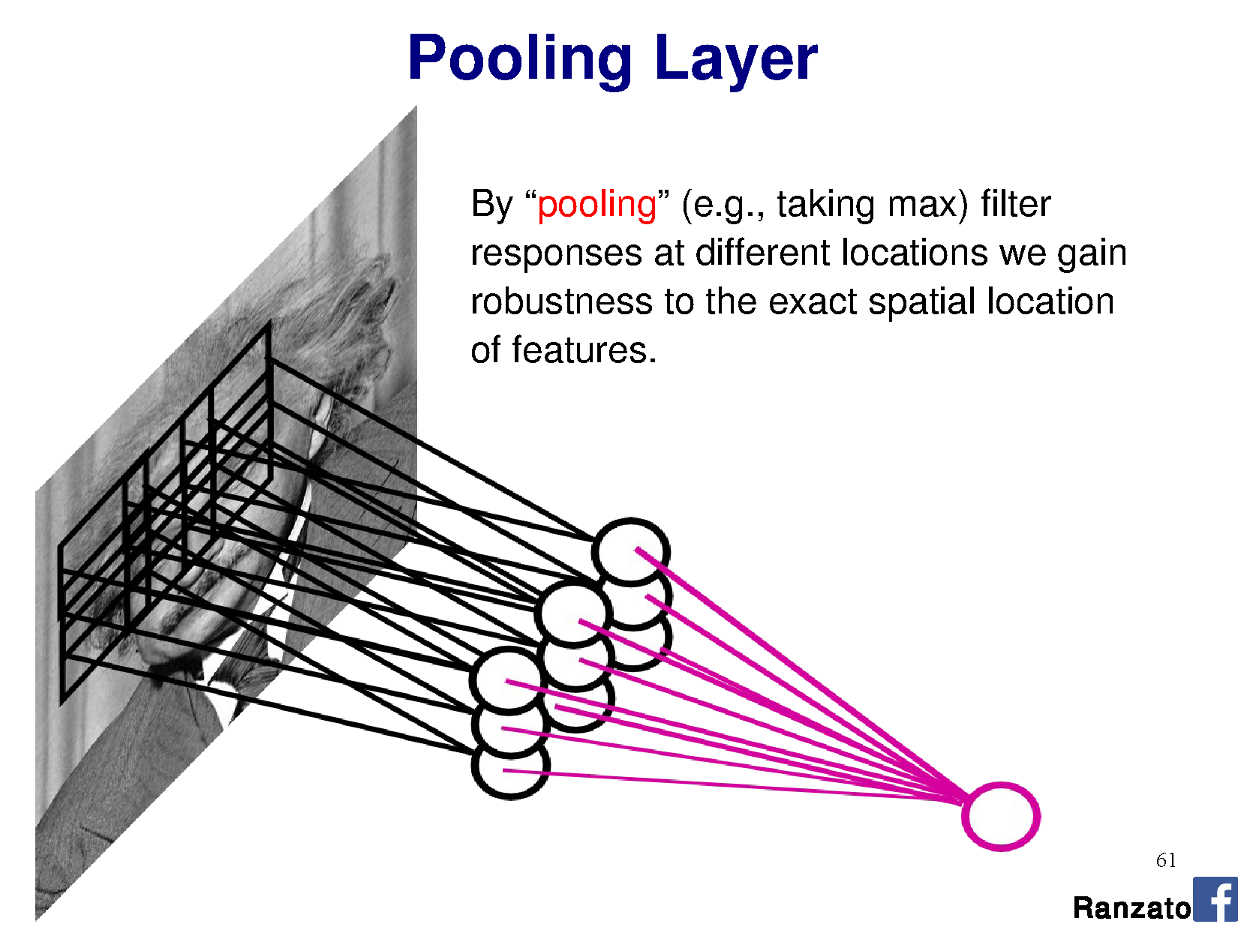
By pooling responses at different locations, we gain robustness to the exact spatial location of image features.

Slide 9
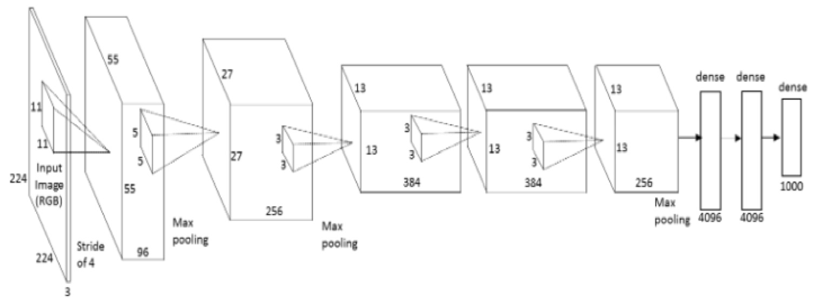
AlexNet diagram (simplified)
[Krizhevsky et al. 2012]
Input size
227 x 227 x 3
227
227
3x3 Stride 2
3x3 Stride 2
Conv 1
11 x 11 x 3
Stride 4
96 filters
Conv 2
5 x 5 x 96
Stride 1
256 filters
Conv 3
3 x 3 x 256
Stride 1
384 filters
Conv 4
3 x 3 x 192
Stride 1
384 filters
Conv 4
3 x 3 x 192
Stride 1
256 filters
Notes:
Input: 227 x 227 x 3 image.
11x11 kernel, stride 4 (AlexNet – 11x11x3 kernels, 96 of them)
5x5 kernel, stride 1, max pool 2x2 (AlexNet – 5x5x48 kernels, 256 of them)
3x3 kernels, (AlexNet – 3x3x256 kernels, 384 of them)
3x3 kernels (AlexNet – 3x3x192 kernels, 384 of them)
3x3 kernels, (AlexNet – 3x3x192 kernels, 256 of them)
FC – 2048 neurons
FC – 2048 neurons
Output – 1000 neurons

Slide 10
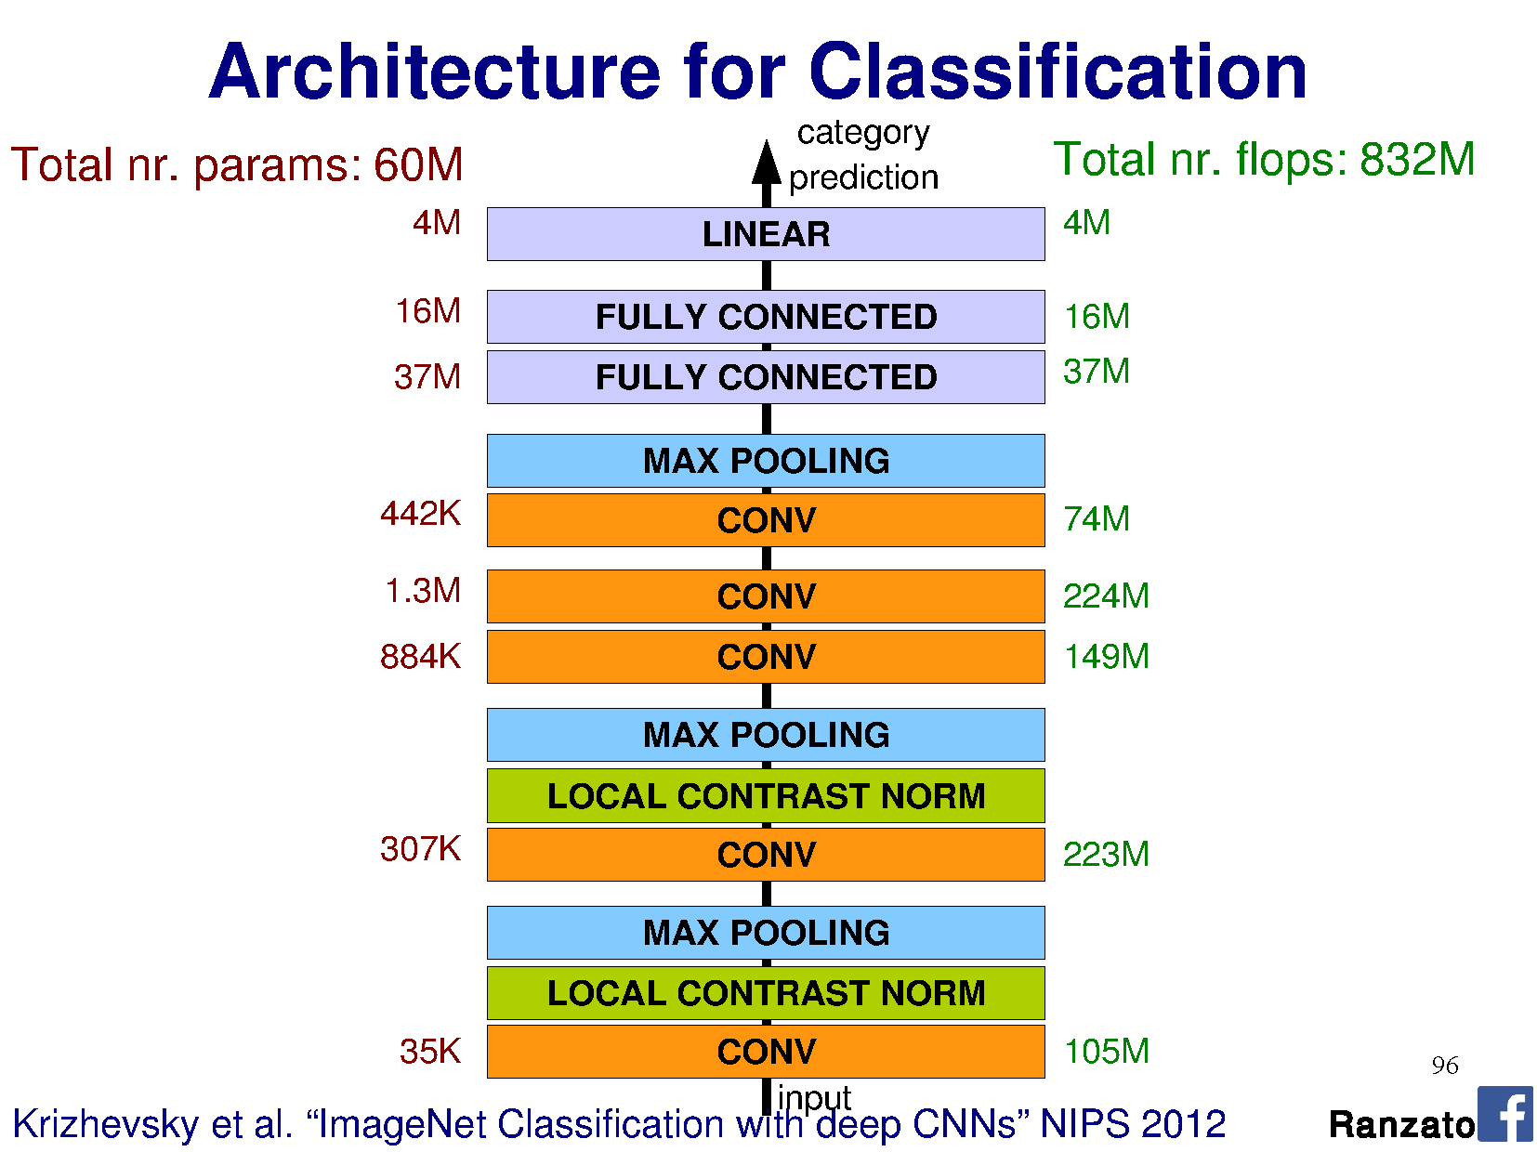
Notes:
FLOPS = just to execute, not train.

Slide 11
Training Neural Networks
Learning the weight matrices W

Slide 12
Gradient descent
f(x)
x
Notes:
Note: this is not a convex function.

Slide 13
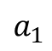
General approach
Pick random starting point.
f(x)
$$a_{1}$$
x

Slide 14
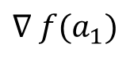
General approach
Compute gradient at point (analytically or by finite differences)
f(x)
$$∇ f(a_{1})$$
$$a_{1}$$
x

Slide 15
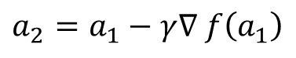
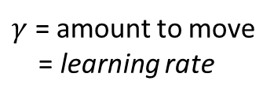
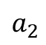
General approach
Move along parameter space in direction of negative gradient
f(x)
$$a_{2}=a_{1}−γ∇ f\left(a_{1}\right)$$
$γ$ = amount to move = learning rate
$$a_{1}$$
$$a_{2}$$
x

Slide 16
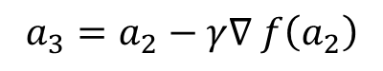
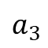
General approach
Move along parameter space in direction of negative gradient.
f(x)
$$a_{3}=a_{2}−γ∇ f\left(a_{2}\right)$$
$γ$ = amount to move = learning rate
$$a_{1}$$
$$a_{2}$$
$$a_{3}$$
x

Slide 17
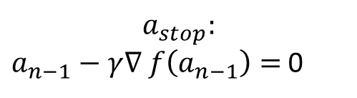
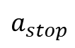
General approach
Stop when we don’t move any more.
f(x)
$$a_{stop}:$$ $a_{n−1}−γ∇ f\left(a_{n−1}\right)=$ 0
$$a_{1}$$
$$a_{2}$$
$$a_{3}$$
$$a_{stop}$$
x

Slide 18
Gradient descent
Optimizer for functions.
Guaranteed to find optimum for convex functions.
Non-convex = find local optimum.
Most vision problems aren’t convex.
Works for multi-variate functions.
Need to compute matrix of partial derivatives (“Jacobian”)
f(x)
x

Slide 19
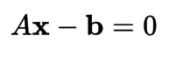
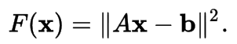
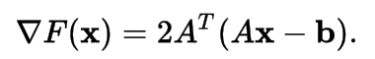
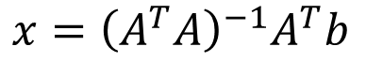
Why would I use this over Least Squares?
If my function is convex, why can’t I just use linear least squares?
Analytic solution = normal equations
You can, yes.
$$x={\left(A^{T}A\right)}^{−1}A^{T}b$$
Notes:
https://en.wikipedia.org/wiki/Linear_least_squares_(mathematics)#Derivation_of_the_normal_equations

Slide 20
Why would I use this over Least Squares?
But now imagine that I have 1,000,000 data points.
Matrices are _huge_.
Even for convex functions, gradient descent allows me to iteratively solve the solution without requiring very large matrices.
We’ll see how.
Notes:
https://en.wikipedia.org/wiki/Linear_least_squares_(mathematics)#Derivation_of_the_normal_equations

Slide 21

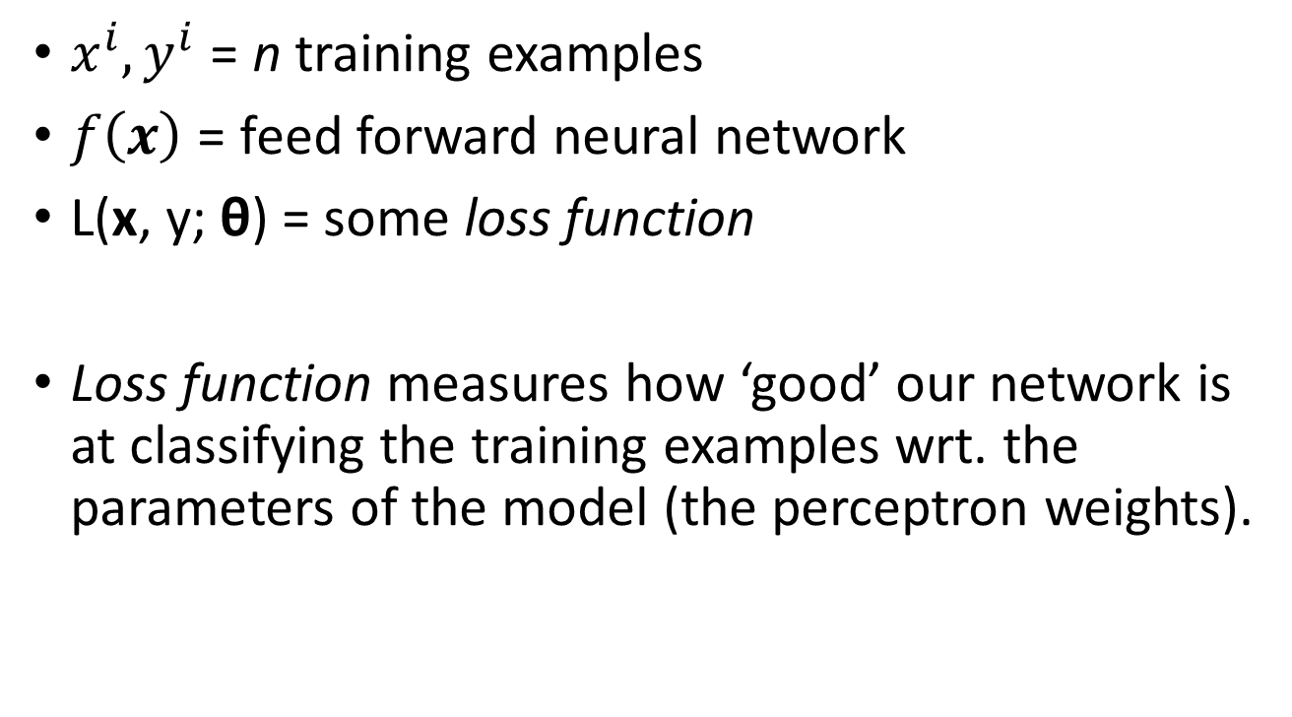
Train NN with Gradient Descent
$x^{i},y^{i}$ = n training examples
$f\left(x\right)$ = feed forward neural network
L(x, y; θ) = some loss function
Loss function measures how ‘good’ our network is at classifying the training examples wrt. the parameters of the model (the perceptron weights).
$$\frac{1}{n}\sum_{i=1}^{n}{{\left\|f\left(x^{i}\right)−y^{i}\right\|}^{2}}$$

Slide 22
Train NN with Gradient Descent
Loss function
(Evaluate NN on training data)
$$a_{1}$$
$$a_{2}$$
$$a_{3}$$
$$a_{stop}$$
Model parameters
(perceptron weights)

Slide 23
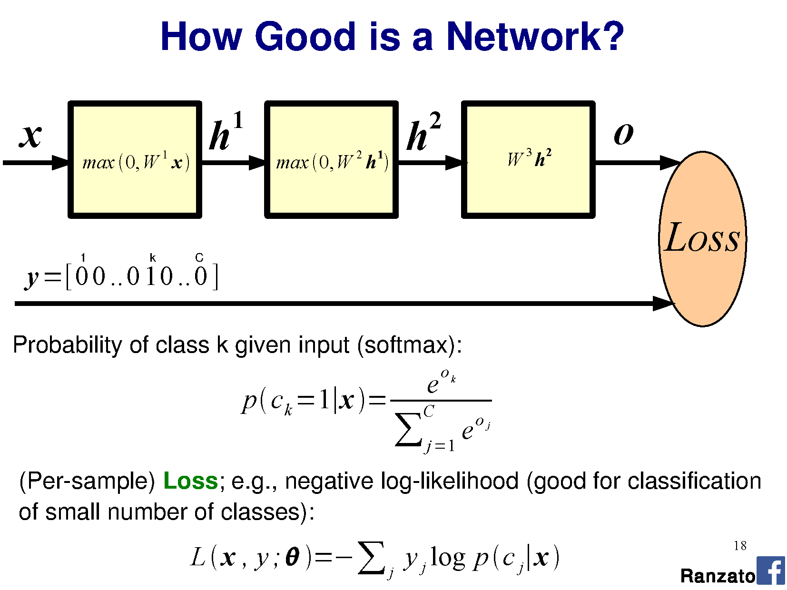
utput

Slide 24
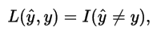
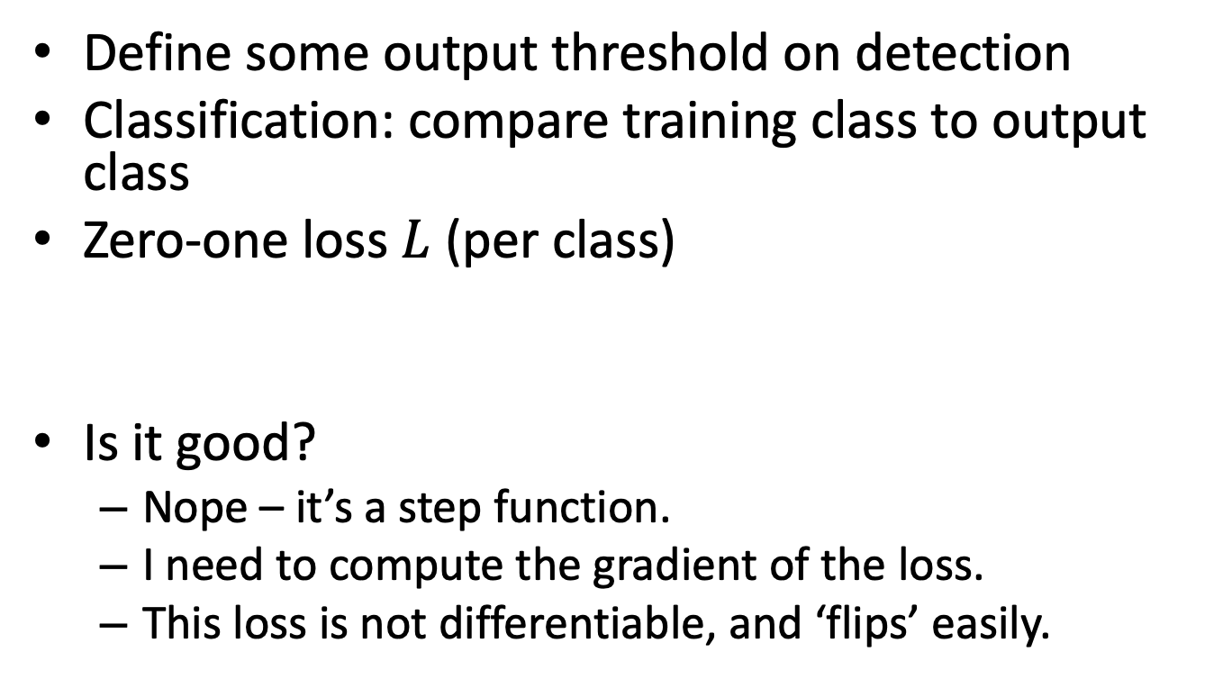
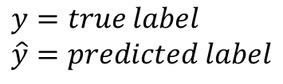
What is an appropriate loss?
Define some output threshold on detection
Classification: compare training class to output class
Zero-one loss $L$(per class)
Is it good?
Nope – it’s a step function.
I need to compute the gradient of the loss.
This loss is not differentiable, and ‘flips’ easily.
$$y=true label \\ \hat{y}=predicted label$$

Slide 25
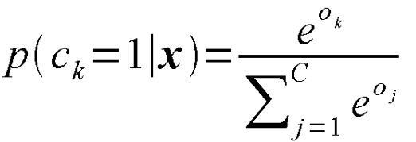
Classification has binary outputs
Special function on last layer - ‘Softmax’:
"squashes" a C-dimensional vector O of arbitrary real values to a C-dimensional vector σ(O) of real values in the range (0, 1) that add up to 1.
Turns the output into a probability distribution on classes.
Notes:
"squashes" a K-dimensional vector z of arbitrary real values to a K-dimensional vector σ ( z ) of real values in the range (0, 1) that add up to 1.
Used as the loss in logistic regression
Add softmax graph
http://dataaspirant.com/2017/03/07/difference-between-softmax-function-and-sigmoid-function/

Slide 26
Softmax
utput
Softmax

Slide 27
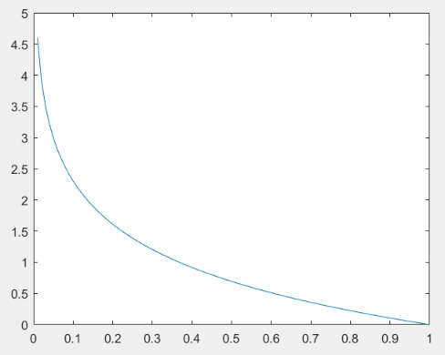
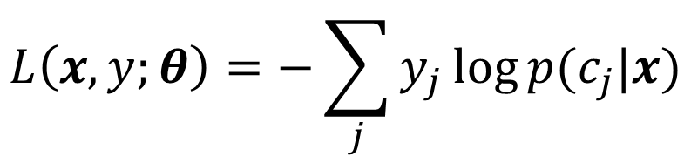
Cross-entropy loss function
Negative log-likelihood
Is it a good loss?
Differentiable
Cost decreases as probability increases
$$L\left(x,y;θ\right)=−\sum_{j}{y_{j}\log{p(c_{j}|x)}}$$
L
p(c_{j}|x)
Notes:
https://en.wikipedia.org/wiki/Loss_functions_for_classification
If p(y) is 0.9, and we classify the object as 0.9, then we would wish for a low loss. -log(p) = ~0.1. So, loss = 0.9 * -log(p) = 0.0949. = low.
If p(y) is 0.1, and we classify the object as 0.9, then we would wish for a high loss. –log(p) = ~0.1. So, loss = 0.-1 = higher.

Slide 28
Softmax
utput

Slide 29
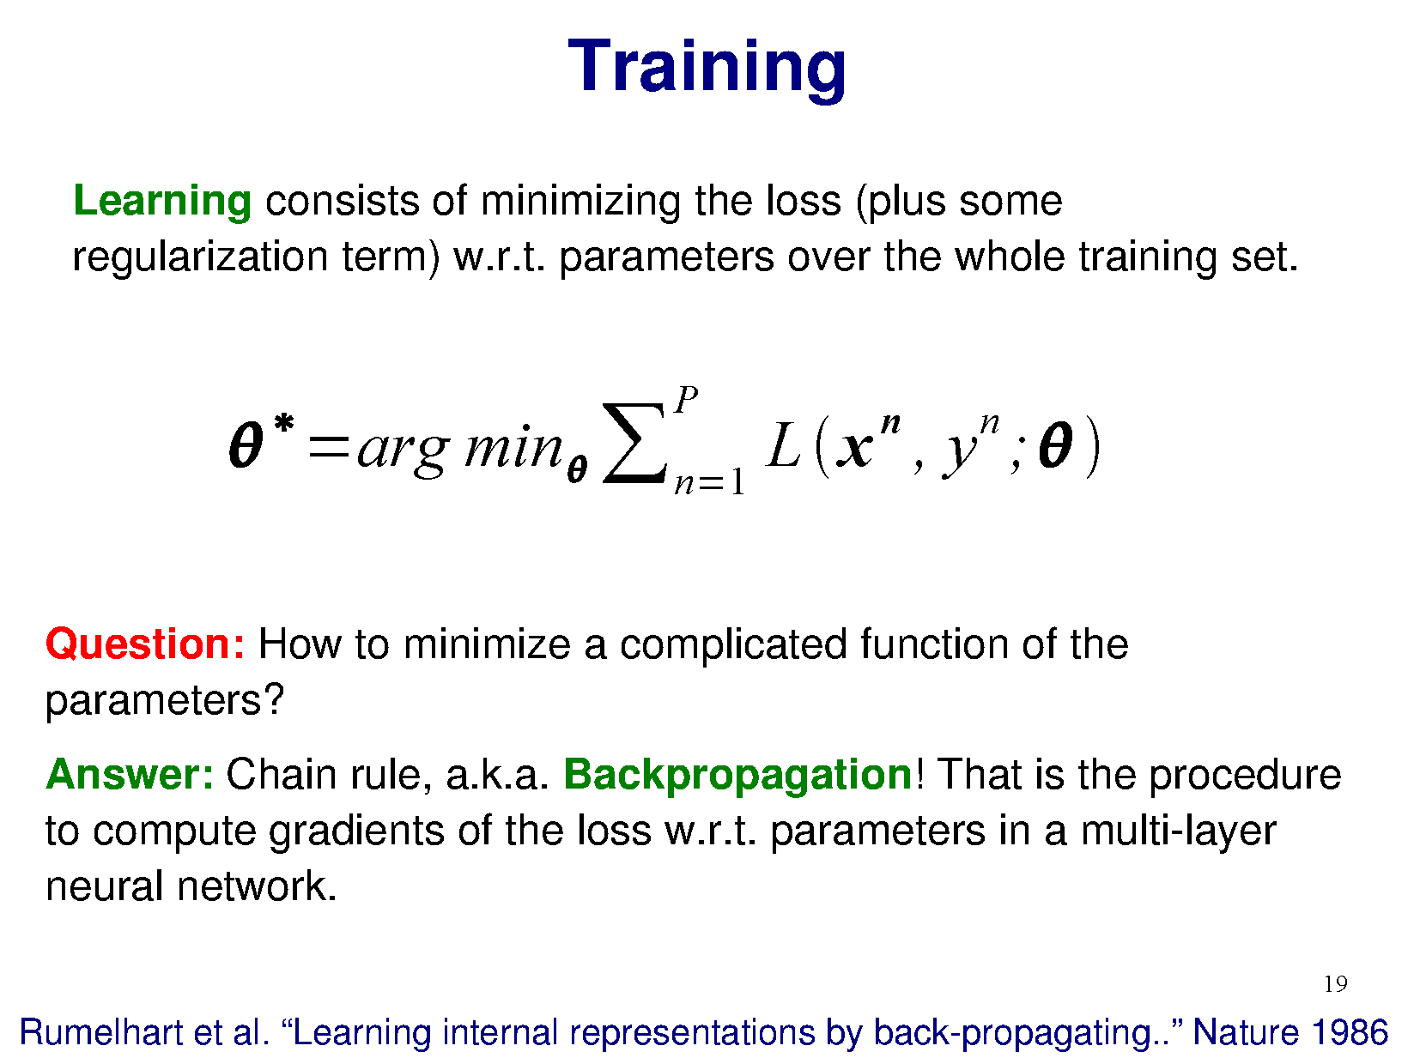

Slide 31
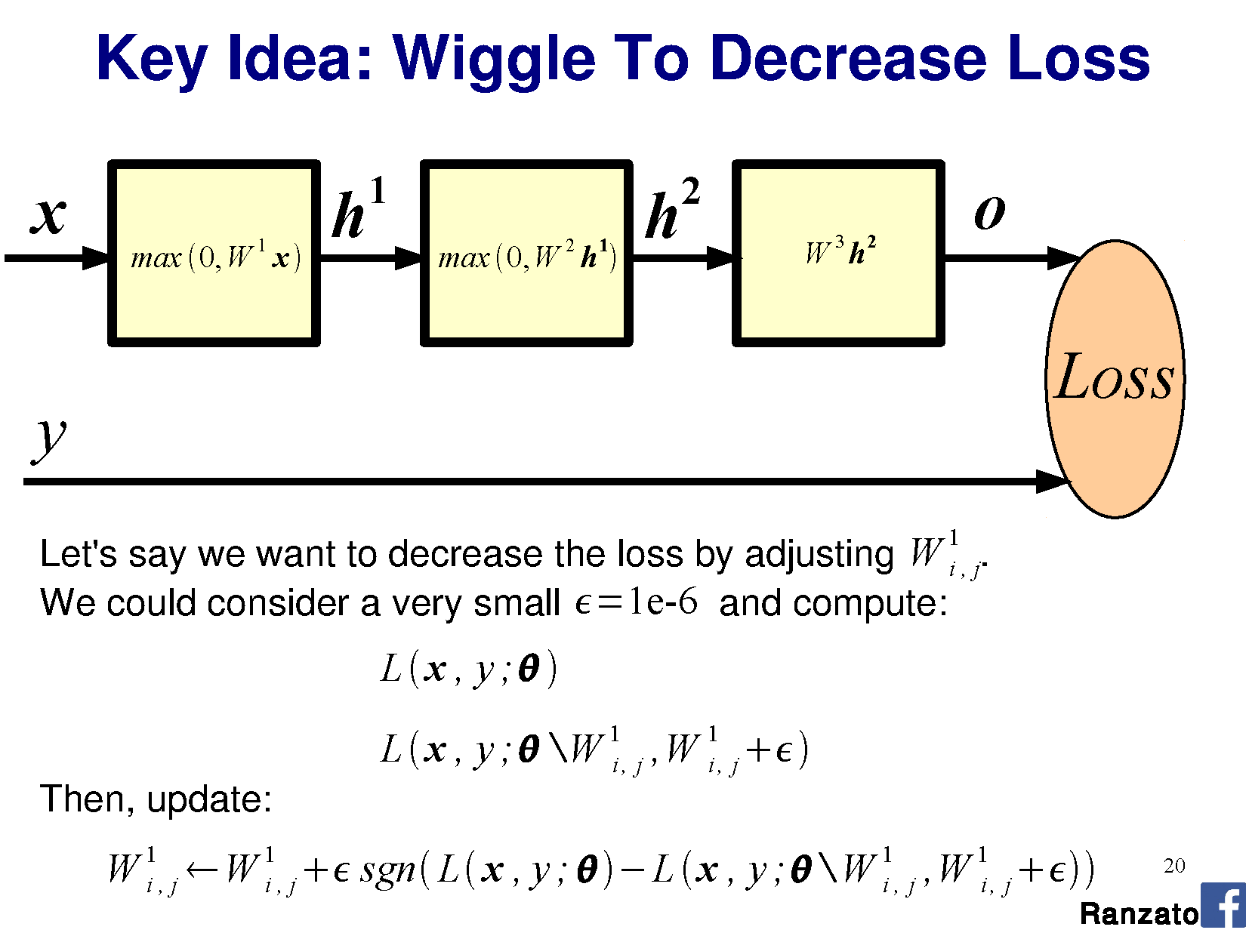

Slide 33
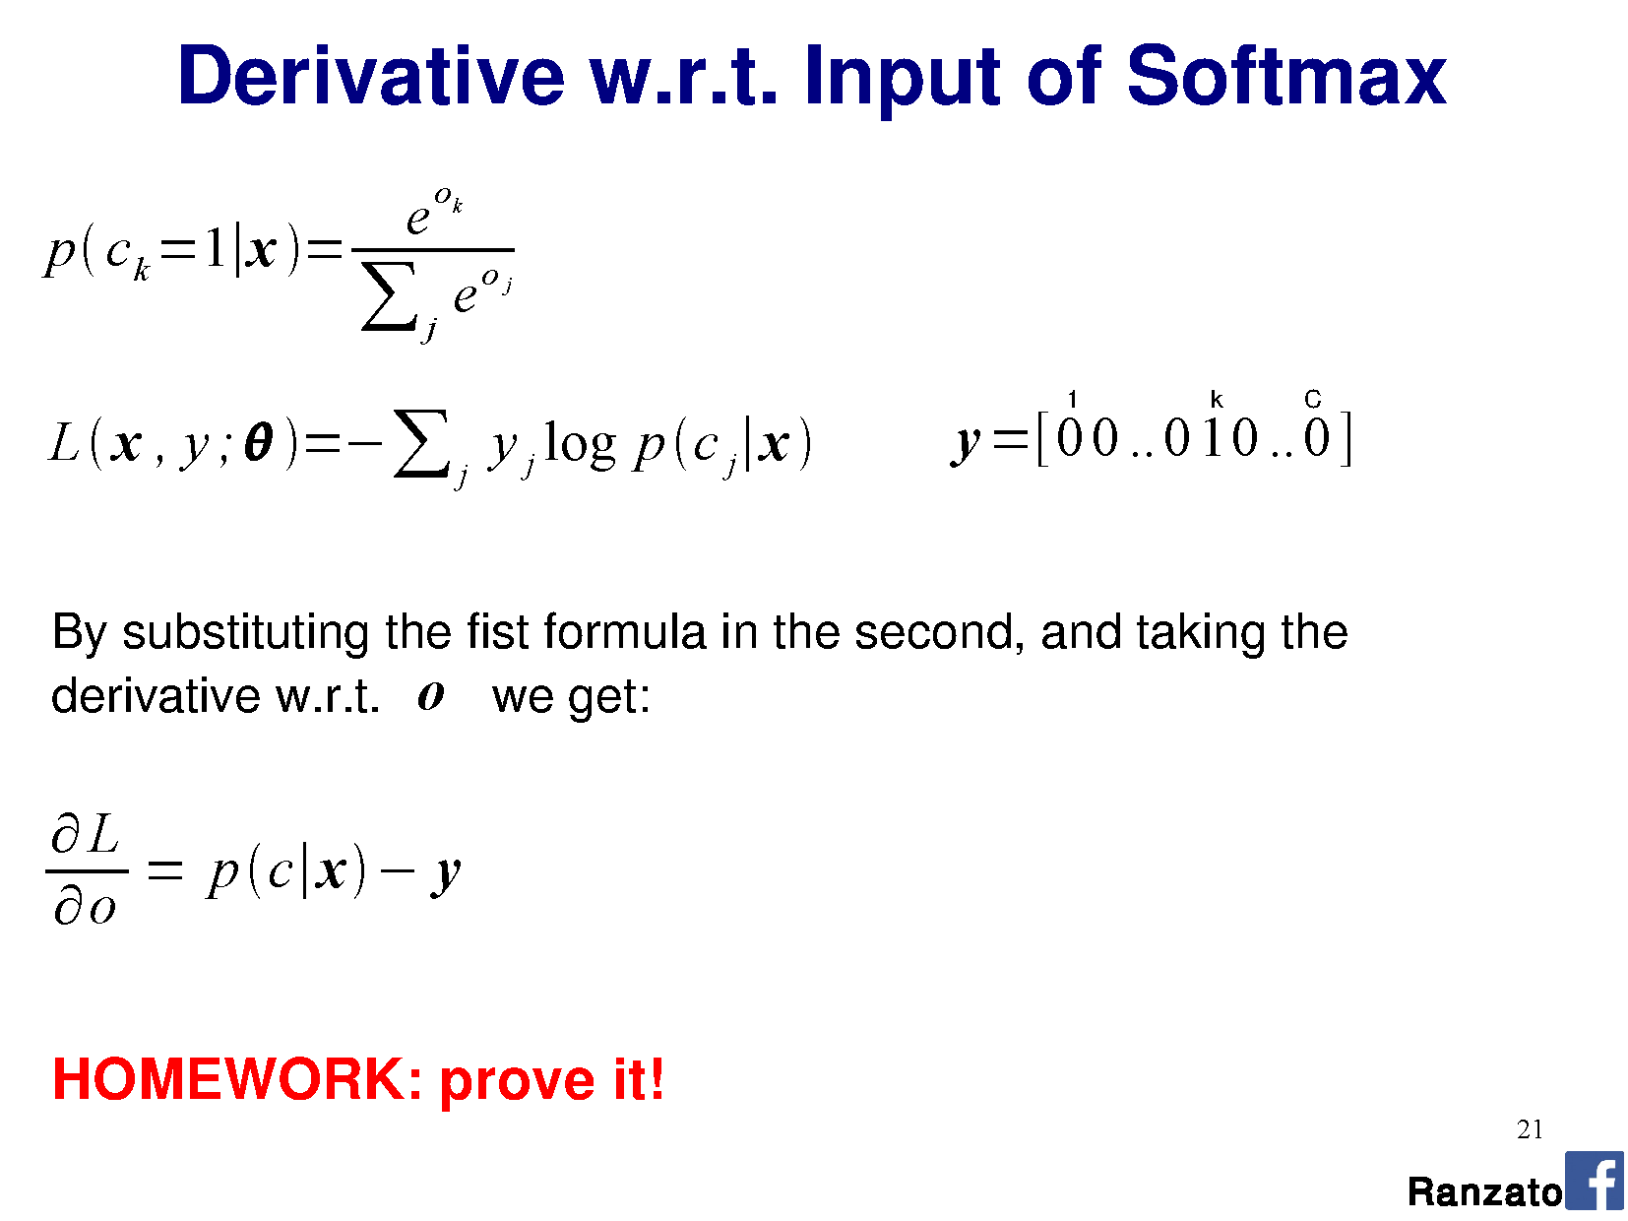

Slide 34
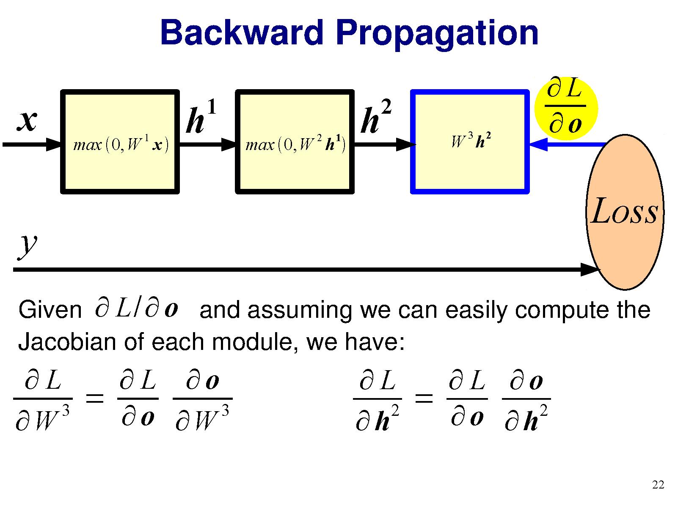
Notes:
Chain rule from calculus on partial derivatives.
Jacobian is matrix of partial derivatives

Slide 35
Notes:
Chain rule from calculus on partial derivatives.

Slide 36
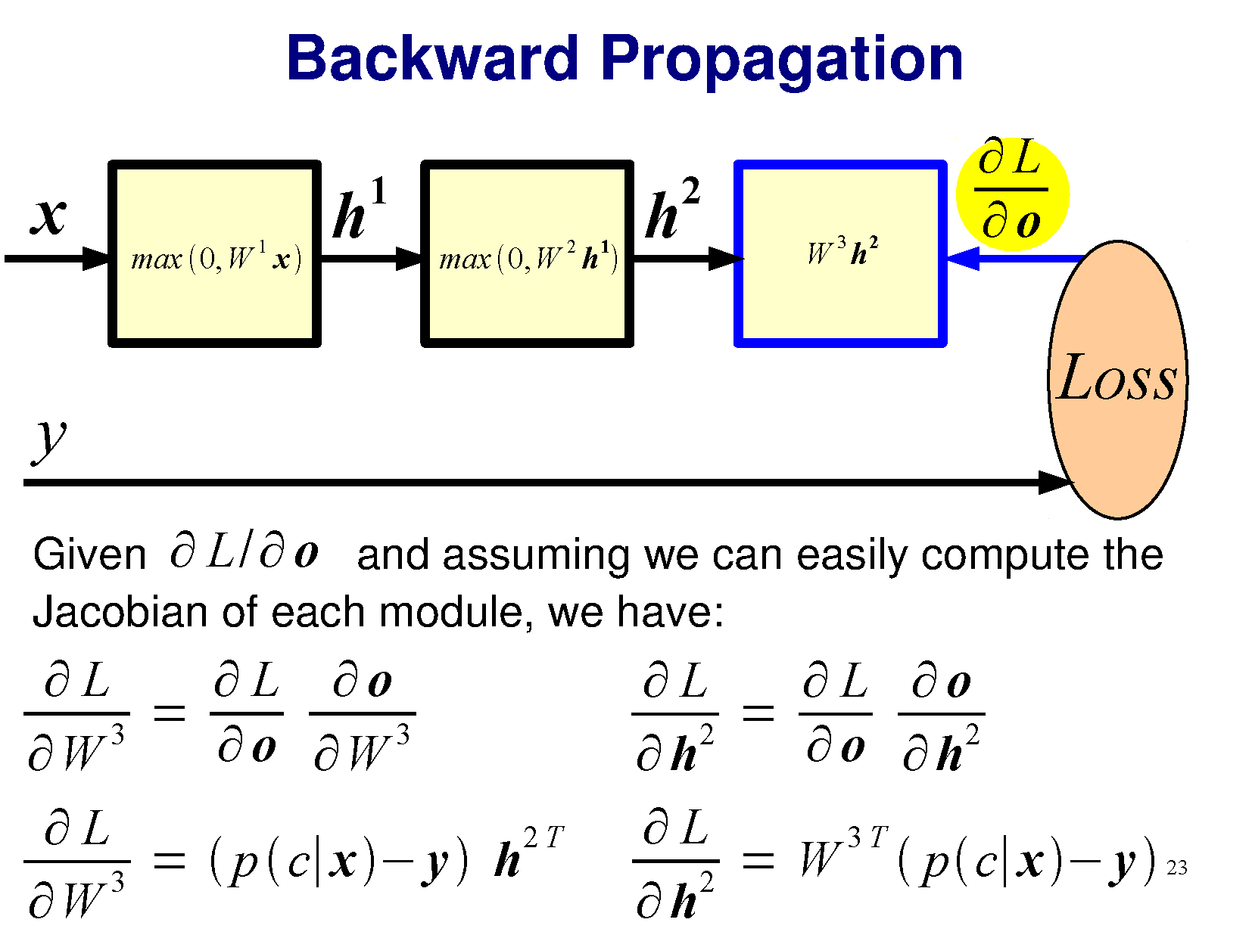

Slide 37
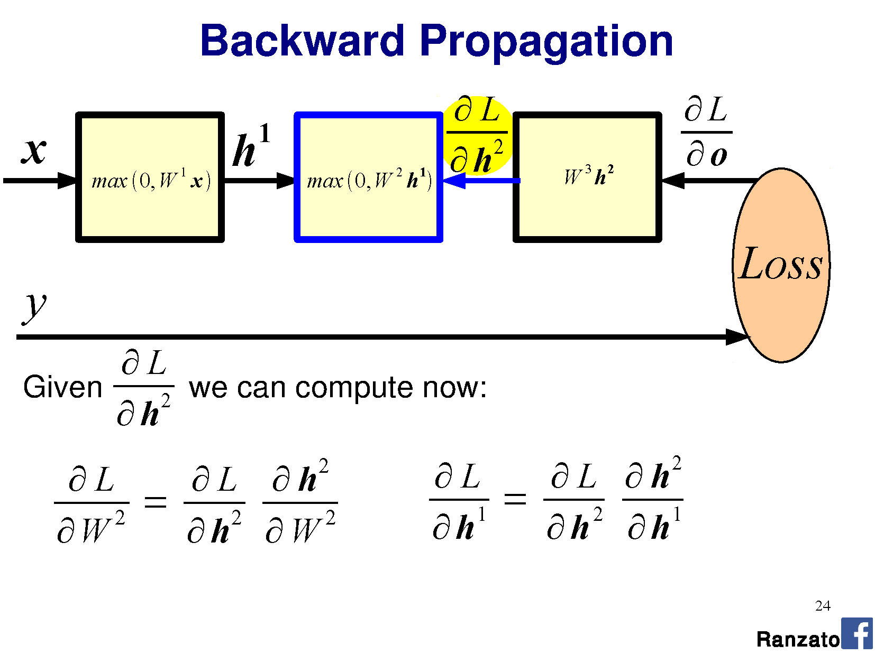

Slide 38
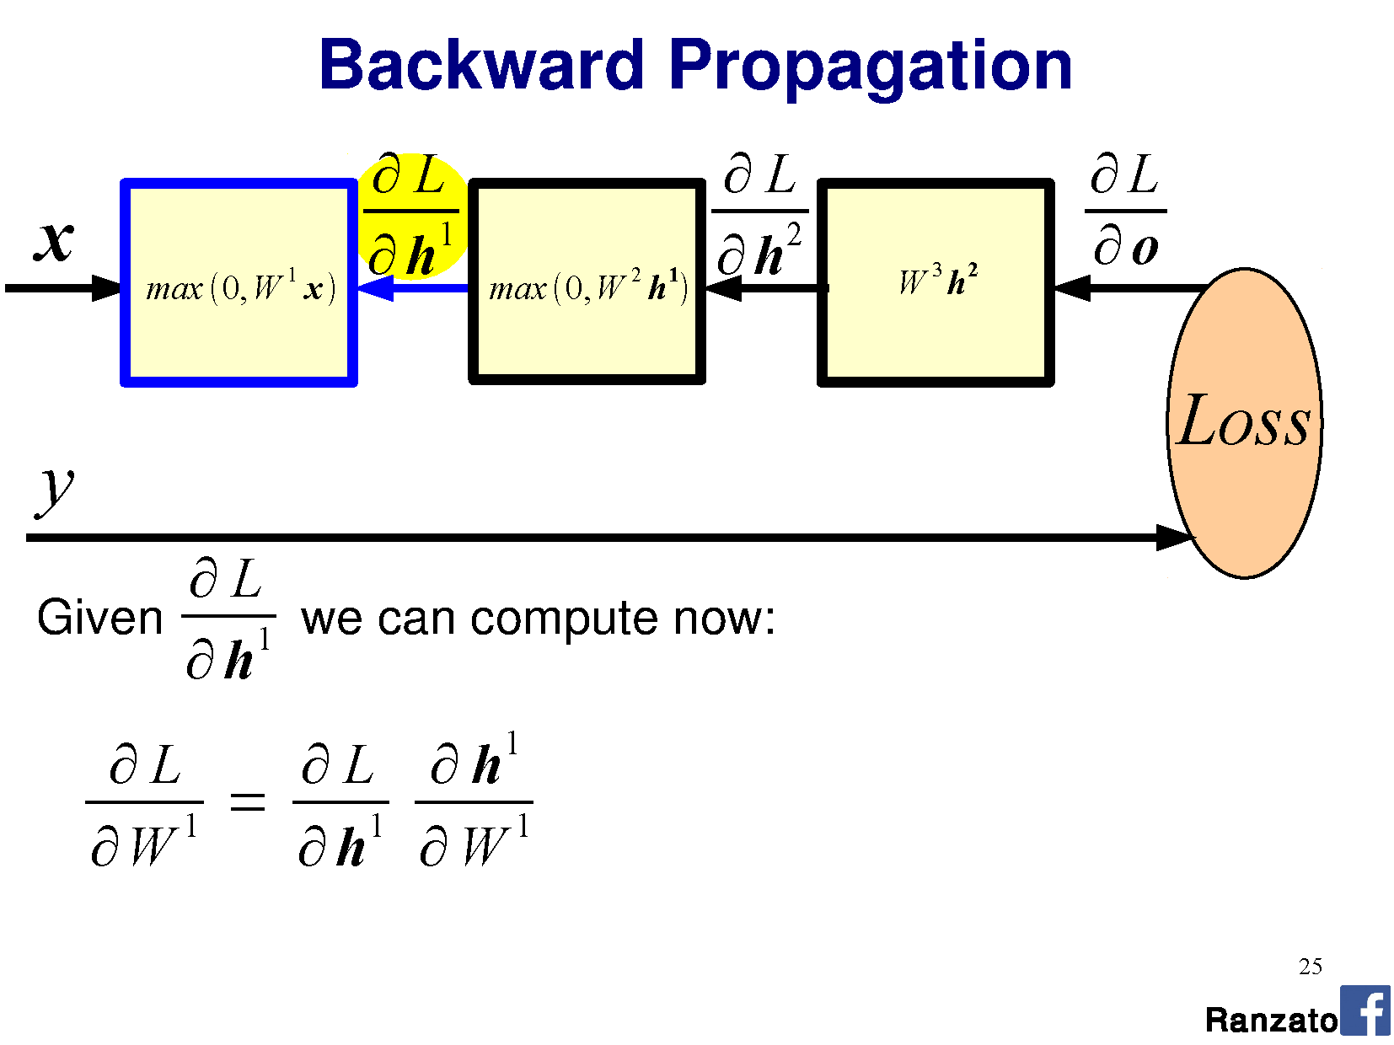

Slide 39
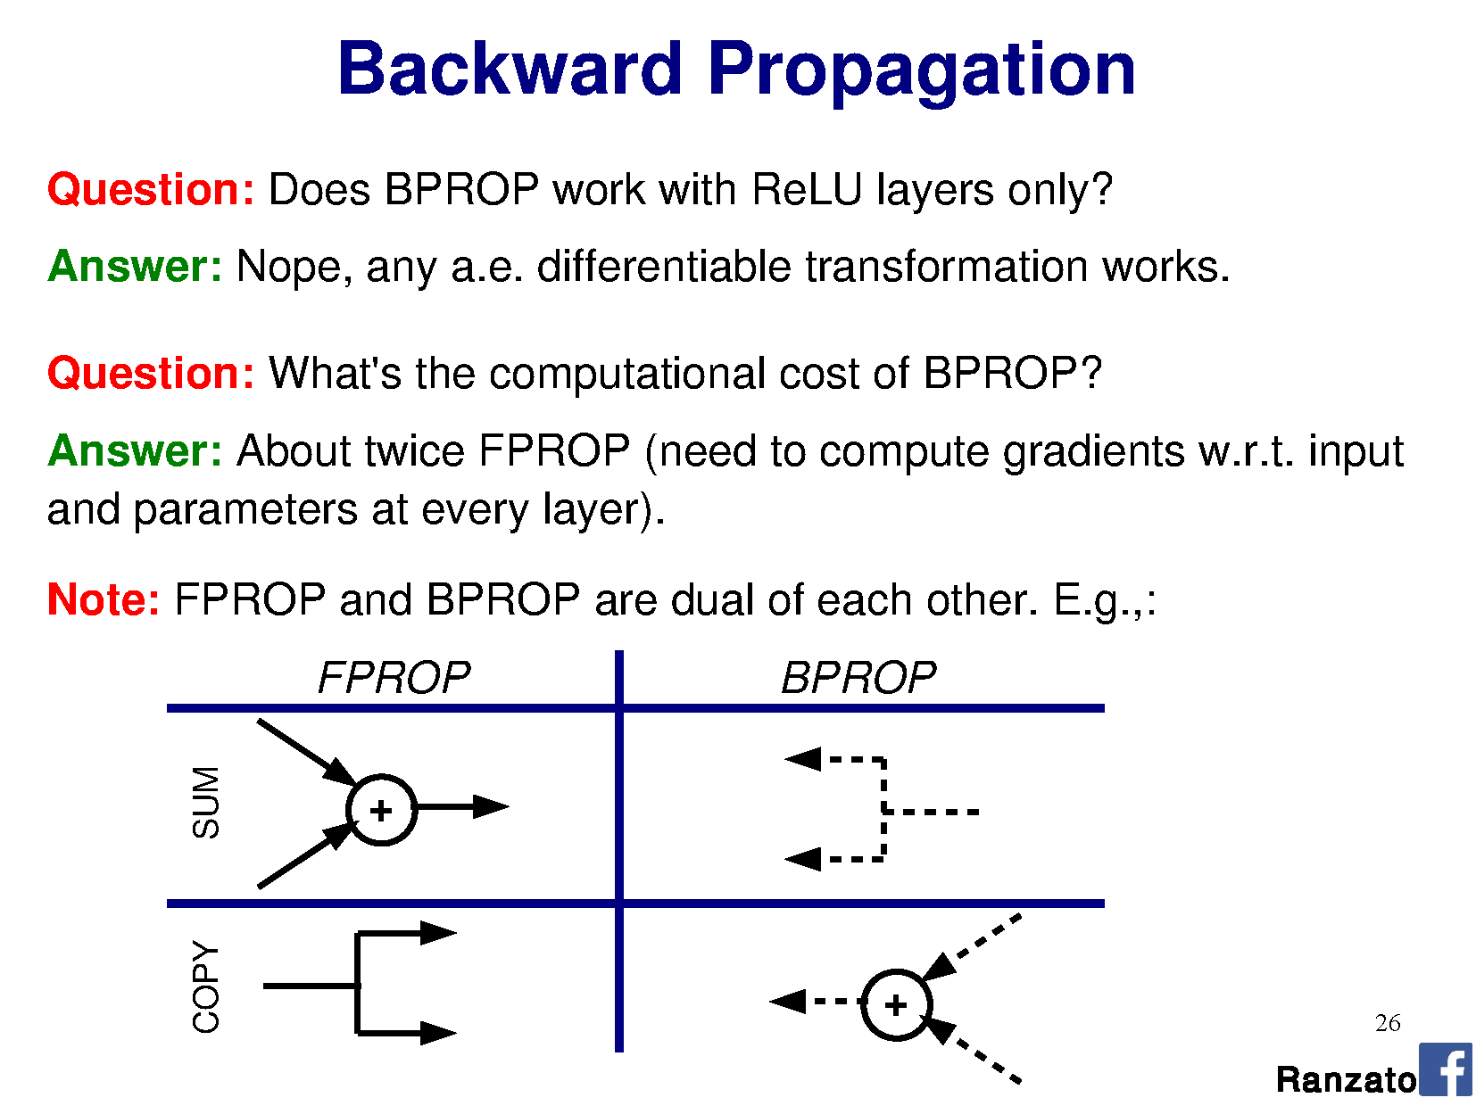
Notes:
a.e. = almost everywhere -> idea from measure theory which states that “a property holds almost everywhere if the set of elements for which the property does not hold is a set of measure zero”
Set of measure zero -> “A set of points capable of being enclosed in intervals whose total length is arbitrarily small.”

Slide 40
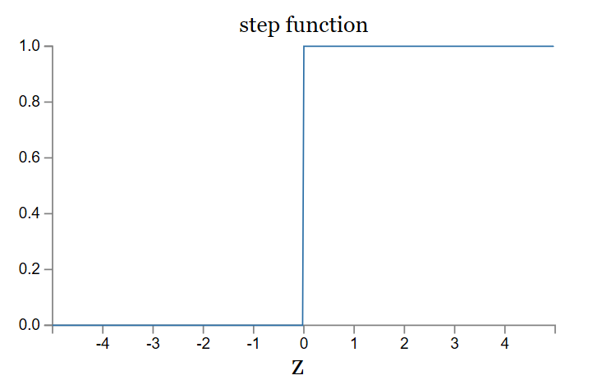
But the ReLU is not differentiable at 0!
Right. Fudge!
‘0’ is the best place for this to occur, because we don’t care about the result (it is no activation).
‘Dead’ perceptrons
ReLU has unbounded positive response:
Potential faster convergence / overstep

Slide 41
Notes:
a.e. = almost everywhere -> idea from measure theory which states that “a property holds almost everywhere if the set of elements for which the property does not hold is a set of measure zero”
Set of measure zero -> “A set of points capable of being enclosed in intervals whose total length is arbitrarily small.”
https://en.wikipedia.org/wiki/Backpropagation

Slide 42
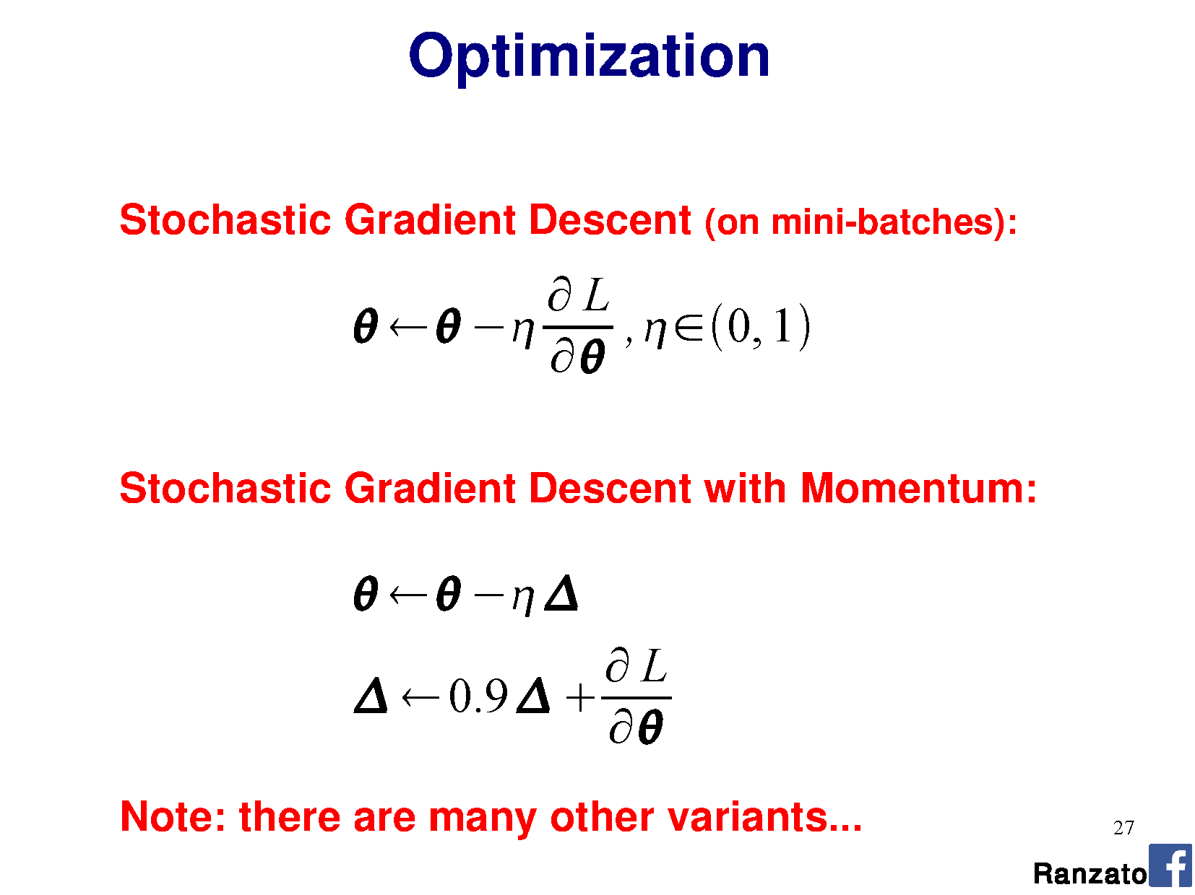

Slide 43
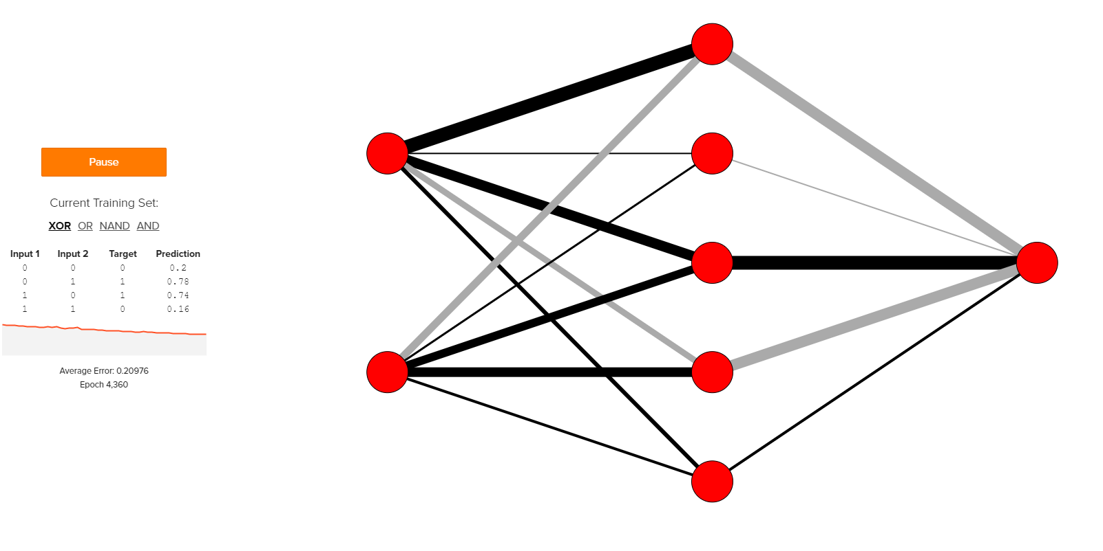
Optimization demo
http://www.emergentmind.com/neural-network
Thank you Matt Mazur
Notes:
https://en.wikipedia.org/wiki/Backpropagation
http://colah.github.io/posts/2015-08-Backprop/

Slide 44
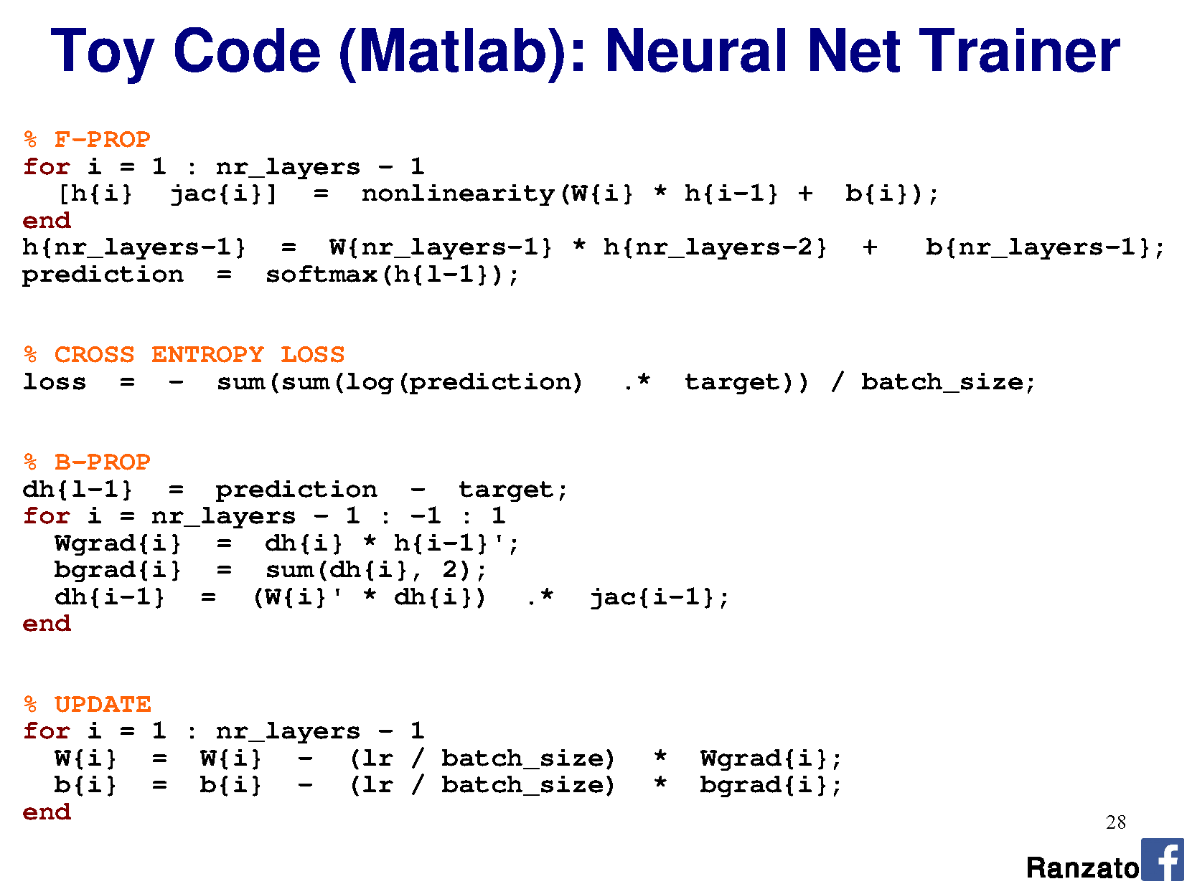

Slide 45
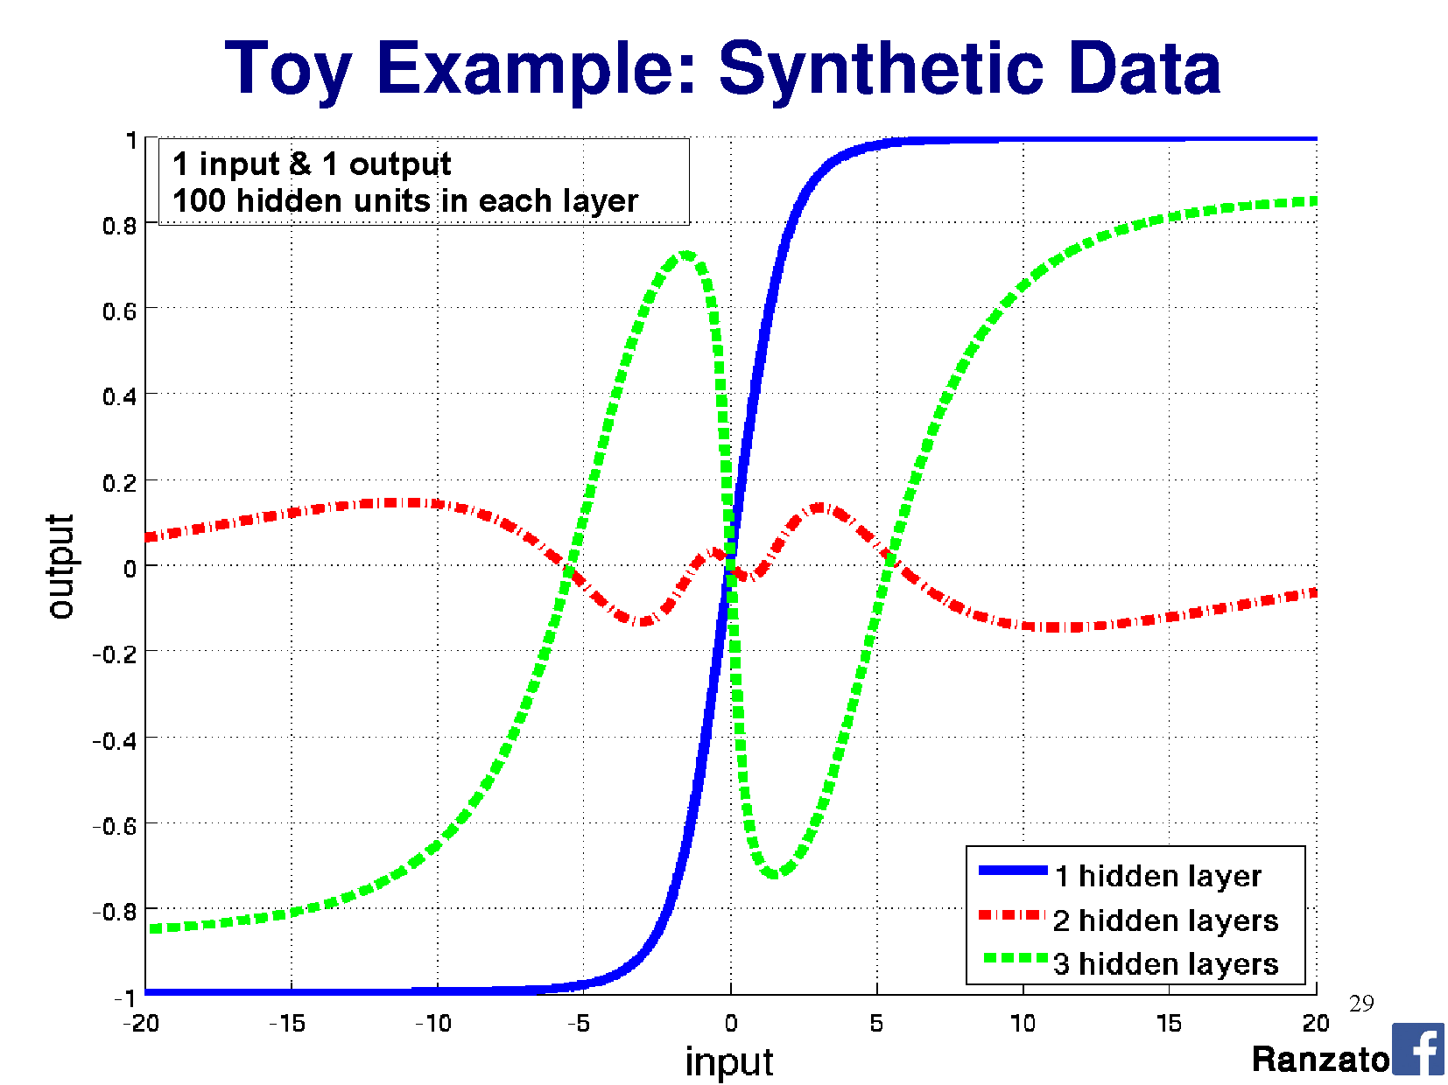

Slide 46
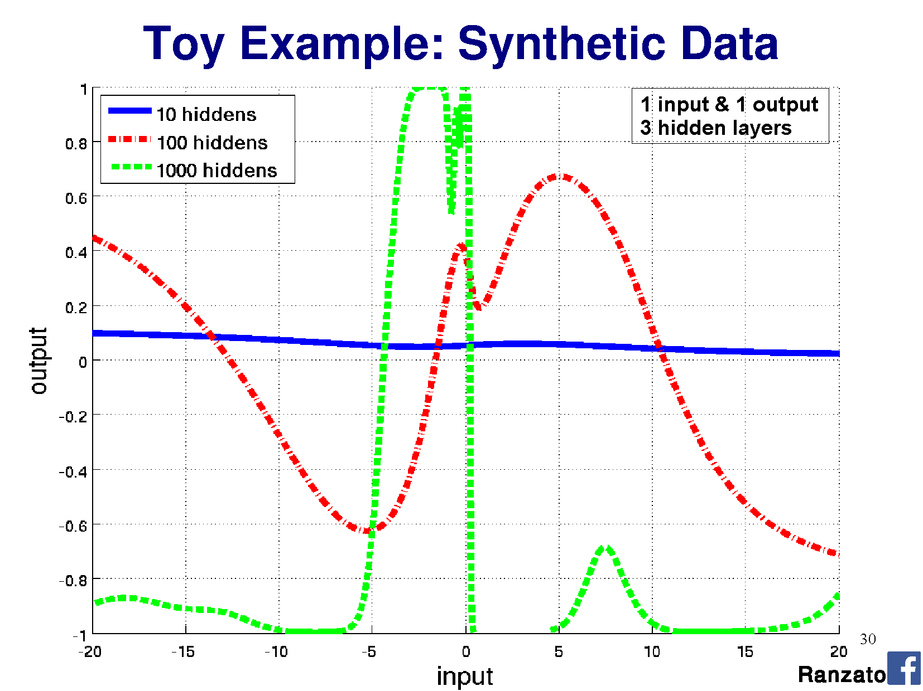

Slide 47
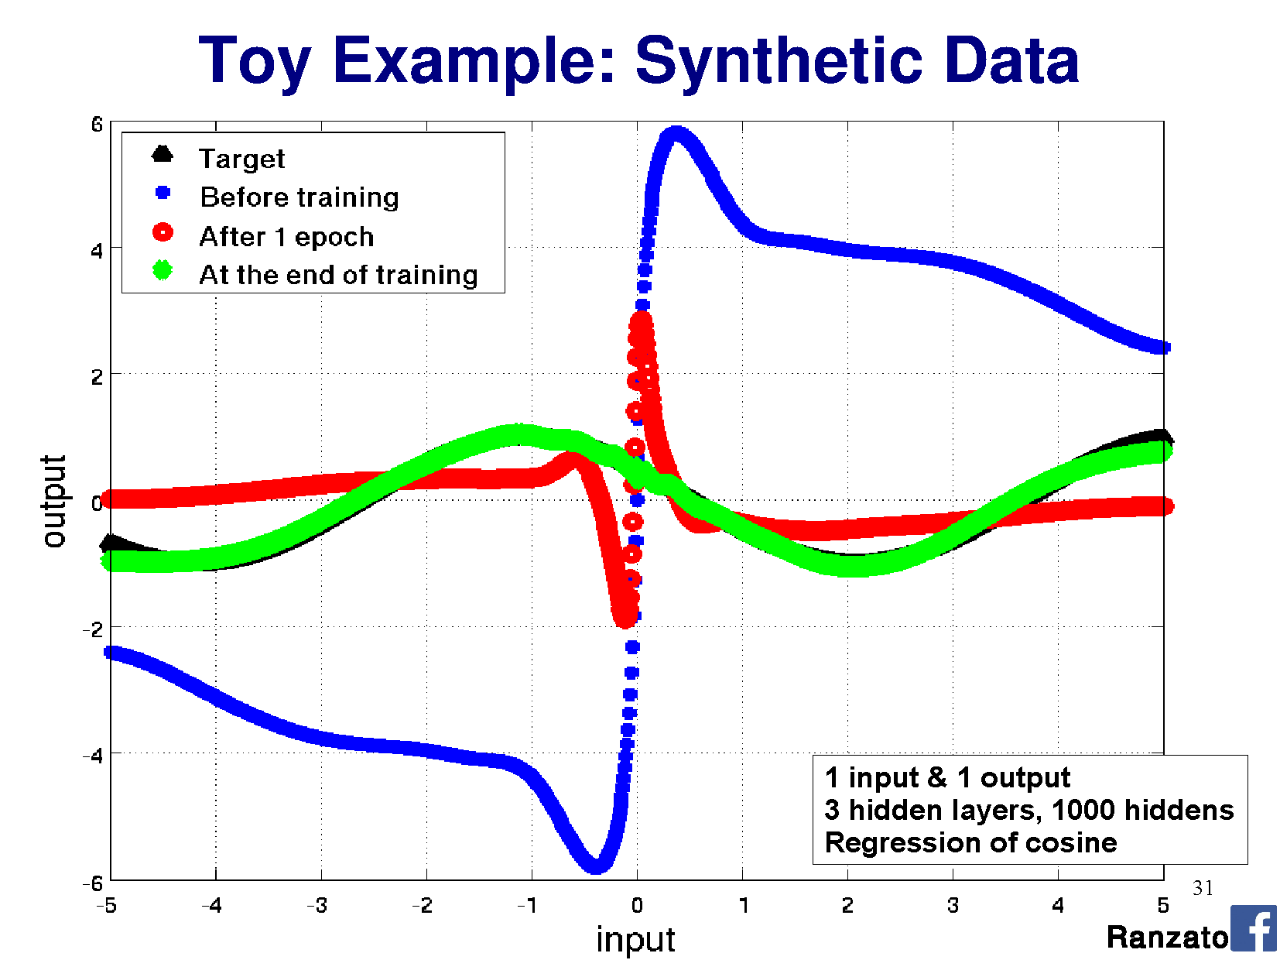

Slide 48
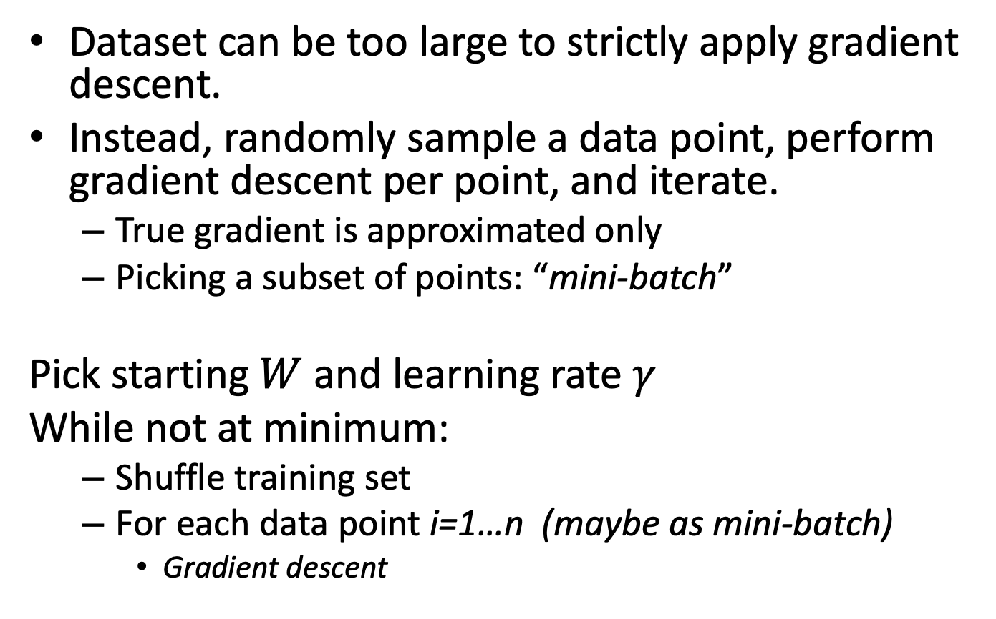
Stochastic Gradient Descent
Dataset can be too large to strictly apply gradient descent.
Instead, randomly sample a data point, perform gradient descent per point, and iterate.
True gradient is approximated only
Picking a subset of points: “mini-batch”
Pick starting $W$ and learning rate $γ$
While not at minimum:
Shuffle training set
For each data point i=1…n (maybe as mini-batch)
Gradient descent
“Epoch“
Notes:
Epoch: running through every training data example and performing SGD
Diagram for different normalizations

Slide 49
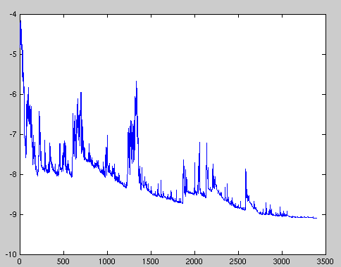
Stochastic Gradient Descent
Loss will not always decrease (locally) as training data point is random.
Still converges over time.
Wikipedia

Slide 50
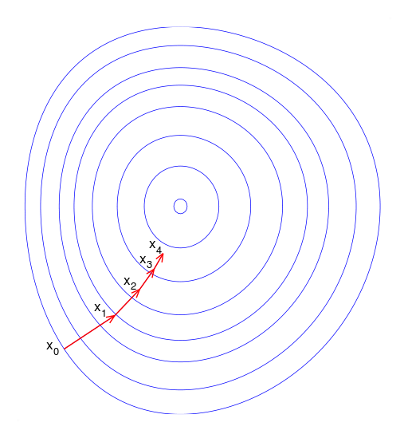
Gradient descent oscillations
Wikipedia

Slide 51
Gradient descent oscillations
Slow to converge to the (local) optimum
Wikipedia

Slide 52

Momentum
Adjust the gradient by a weighted sum of the previous amount plus the current amount.
Without momentum: $θ_{t+1}= θ_{t} − γ\frac{∂L}{∂θ}$
With momentum (new $α$parameter):
$θ_{t+1}= θ_{t} − γ\left(α{\left[\frac{∂L}{∂θ}\right]}_{t−1}+{\left[\frac{∂L}{∂θ}\right]}_{t}\right)$
Notes:
Called momentum because it forces the gradient to change more slowly, and helps prevent oscillations

Slide 53
But James…
…I thought we were going to treat machine learning like a black box? I like black boxes.
Deep learning is: - a black box
Training data
Classifier

Slide 54

But James…
…I thought we were going to treat machine learning like a black box? I like black boxes.
Deep learning is: - a black box - also a black art.
http://www.isrtv.com/
Notes:
http://www.isrtv.com/forums/topic/12039-custom-button-box-for-iracing/

Slide 55
But James…
…I thought we were going to treat machine learning like a black box? I like black boxes.
Many approaches and hyperparameters:
Activation functions, learning rate, mini-batch size, momentum…
Often these need tweaking, and you need to know what they do to change them intelligently.

Slide 56



Nailing hyperparameters + trade-offs
Notes:
Aaron in March/April 2017

Slide 57
Lowering the learning rate = smaller steps in SGD
-Less ‘ping pong’
-Takes longer to get to the optimum
Wikipedia

Slide 58


Flat regions in energy landscape
Notes:
Also lets us see how different kinds of learning algorithms work.

Slide 59
Problem of fitting
Too many parameters = overfitting
Not enough parameters = underfitting
More data = less chance to overfit
How do we know what is required?

Slide 60
Regularization
Attempt to guide solution to not overfit
But still give freedom with many parameters

Slide 61

Data fitting problem
[Nielson]

Slide 62


Which is better? Which is better a priori?
9th order polynomial
1st order polynomial
[Nielson]
Notes:
How do we know a priori how many parameters we need?
Cross-validation is one way.

Slide 63
Regularization
Attempt to guide solution to not overfit
But still give freedom with many parameters
Idea: Penalize the use of parameters to prefer small weights.

Slide 64



Regularization:
Idea: add a cost to having high weights
$λ$ = regularization parameter
$$λ$$
[Nielson]
Notes:
n is size of training data
Intuitively, the effect of regularization is to make it so the network prefers to learn small weights, all other things being equal. Large weights will only be allowed if they considerably improve the first part of the cost function. Put another way, regularization can be viewed as a way of compromising between finding small weights and minimizing the original cost function.

Slide 65
Both can describe the data…
…but one is simpler.
Occam’s razor:
“Among competing hypotheses, the one with the fewest assumptions should be selected”
For us:
Large weights cause large changes in behaviour in response to small changes in the input.
Simpler models (or smaller changes) are more robust to noise.
Notes:
Why does this help reduce overfitting?

Slide 66


Regularization
Idea: add a cost to having high weights
$λ$ = regularization parameter
$$λ$$
$$λ$$
Normal cross-entropy loss (binary classes)
Regularization term
[Nielson]
Notes:
n is size of training data
Intuitively, the effect of regularization is to make it so the network prefers to learn small weights, all other things being equal. Large weights will only be allowed if they considerably improve the first part of the cost function. Put another way, regularization can be viewed as a way of compromising between finding small weights and minimizing the original cost function.

Slide 67

Regularization: Dropout
Our networks typically start with random weights.
Every time we train = slightly different outcome.
Why random weights?
If weights are all equal, response across filters will be equivalent.
Network doesn’t train.
[Nielson]
Notes:
http://stackoverflow.com/questions/20027598/why-should-weights-of-neural-networks-be-initialized-to-random-numbers

Slide 68
Regularization
Our networks typically start with random weights.
Every time we train = slightly different outcome.
Why not train 5 different networks with random starts and vote on their outcome?
Works fine!
Helps generalization because error is averaged.
Notes:
Any problem here?
But, kind of slow?

Slide 69

Regularization: Dropout
[Nielson]

Slide 70

Regularization: Dropout
At each mini-batch:
Randomly select a subset of neurons.
Ignore them.
On test: half weights outgoing to compensate for training on half neurons.
Effect:
Neurons become less dependent on output of connected neurons.
Forces network to learn more robust features that are useful to more subsets of neurons.
Like averaging over many different trained networks with different random initializations.
Except cheaper to train.
[Nielson]

Slide 71
Many forms of ‘regularization’
Adding more data is a kind of regularization
Pooling is a kind of regularization
Data augmentation is a kind of regularization

